Slide 1
Transcription Factor Analysis
Last week, we discussed how to use functional analysis - GO Ontology or KEGG Pathways - to make biological sense of a list of genes
You can use this approach for any list of genes - differential expression or clustered by an algorithm
Today, we will learn to ask: what is the mechanism that explains why these genes are acting in tandem?
Notes:
Network node-→driving correlation with it transcription factor…

Slide 2
Understanding Gene Regulation
How many genes are there in the human genome?
Are splice variants extremely common and used to provide diversity, or are they functionally inconsequential and mostly the result of splicing errors?
How much of the human genome is actively involved in regulation and transcription?

Slide 3
How many genes?
Estimates that rely on manual curation have a smaller number
Computational approaches using large datasets such as GTEX find
21,306 protein-coding genes and 21,856 non-coding genes
But it isn’t clear whether they are “real” genes - just because mRNA is expressed doesn’t make it functionally active
https://www.nature.com/articles/d41586-018-05462-w

Slide 4
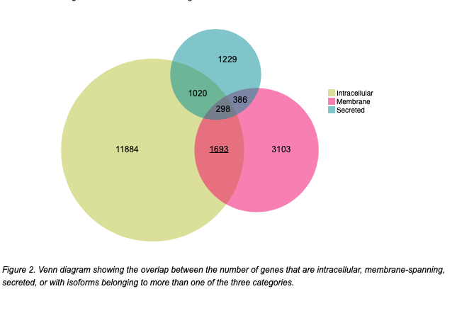
How common are splice variants?
Most genes are listed as having > 5 splice variants in the databases
According to Human Protein Atlas, some 10 percent of genes have alternative splice variants that would result in proteins targeted to different cellular components
Other estimates are that < 1 percent of alternative splicing variants are functionally important, the rest are due to the high error rate of splicing

Slide 5
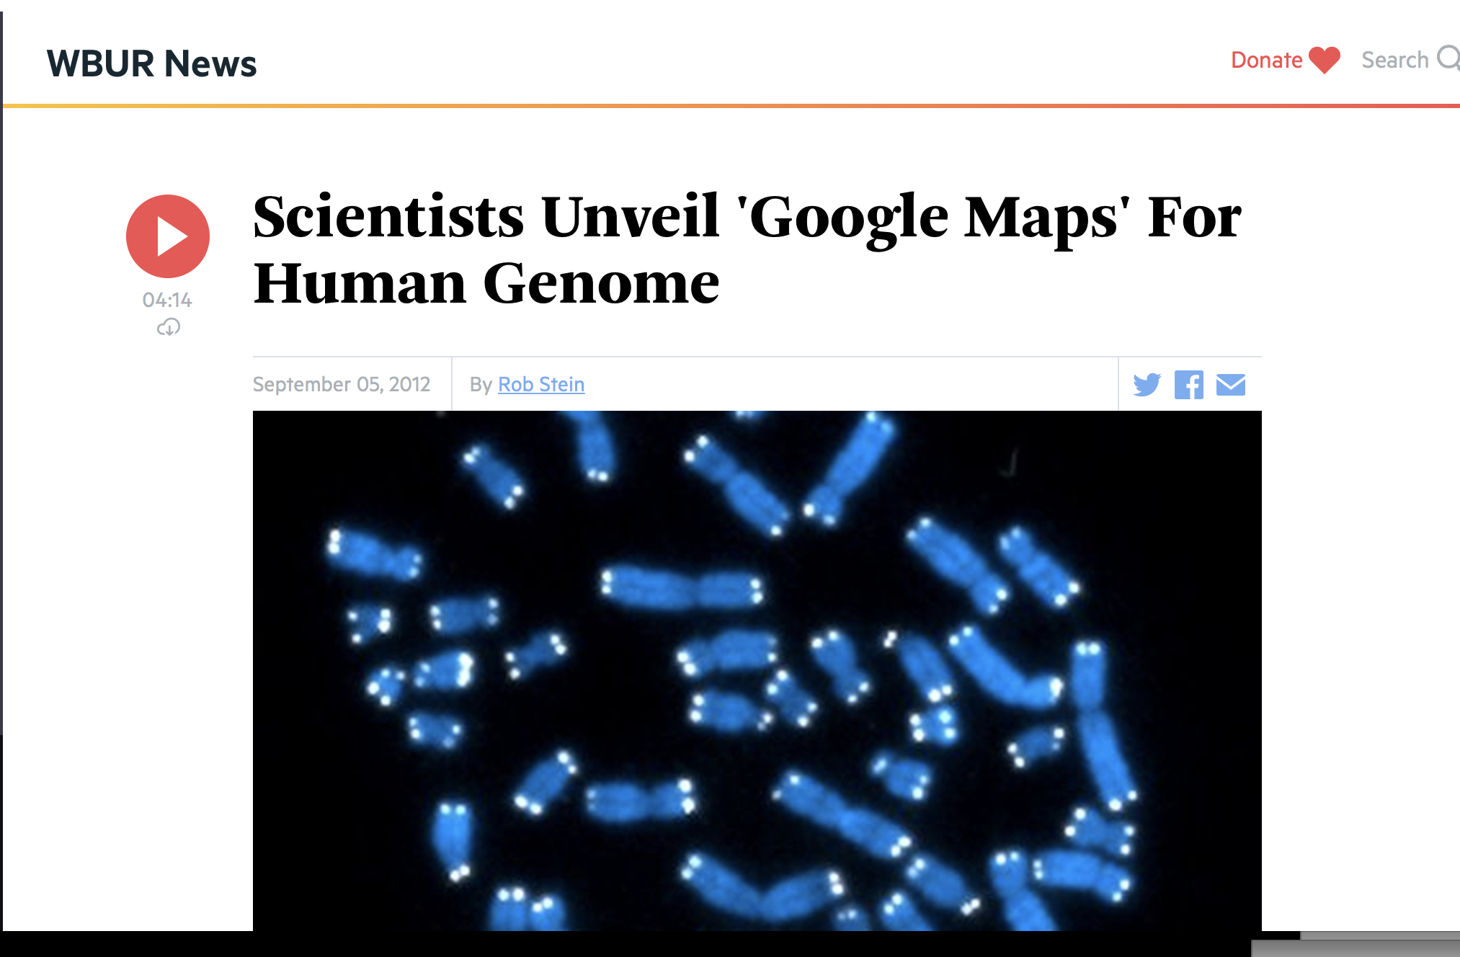
How much of the human genome is actively involved in transcription?
ENCODE claimed to have revealed that contrary to claims that only 10 percent of the human genome was functionally important, 80 percent was! Specifically:
-> 74.7% transcribed
-> 56.1% associated with modified histones
-> 15.2% found in open-chromatin areas
-> 8.5% binds transcription factors,
-> 4.6% consists of methylated CpG dinucleotide
Type to enter a caption.
Surely a Google Map of the human genome is worth $200 Million!

Slide 6
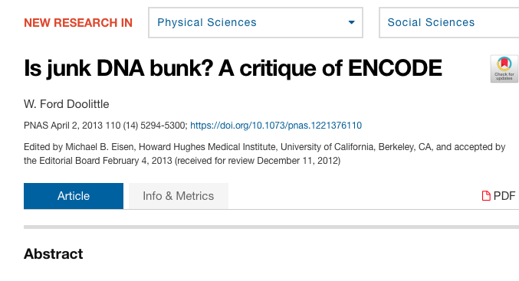
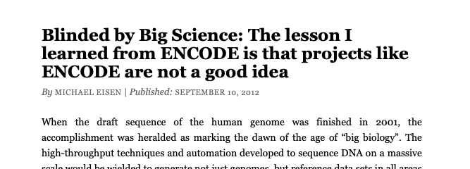
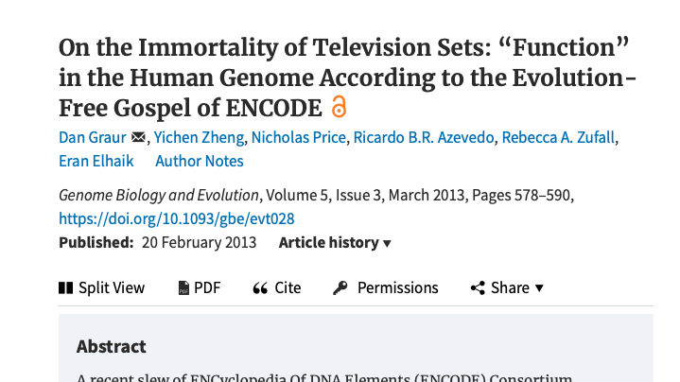
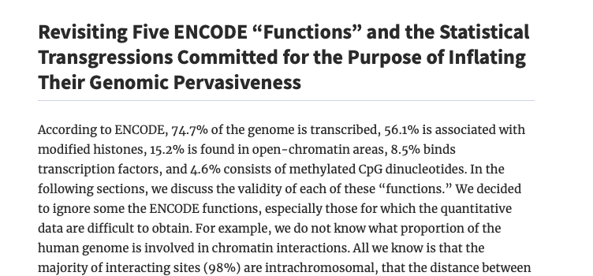
How much of the human genome is actively involved in transcription?
“ENCODE accomplishes these aims mainly by playing fast and loose with the term “function,” by divorcing genomic analysis from its evolutionary context and ignoring a century of population genetics theory, and by employing methods that consistently overestimate functionality, while at the same time being very careful that these estimates do not reach 100%. More generally, the ENCODE Consortium has fallen trap to the genomic equivalent of the human propensity to see meaningful patterns in random data—known as apophenia Brugger 2001; Fyfe et al. 2008)—that have brought us other “codes” in the past (Witztum 1994; Schinner 2007).
Notes:
ENCODE Transcription artificial system--- overestimate…

Slide 7
Some things to ponder:
If 80 percent of human DNA is “functionally” important, is this a unique human property? Or is it shared by all creatures?
If it is, why do onions need a genome 5x the size of humans? What are axotl’s doing with their genome - 10x the size of humans?

Slide 8
Some things to ponder:
“I would be quite proud to have served on the committee that designed the E. coli genome. There is, however, no way that I would admit to serving on a committee that designed the human genome. Not even a university committee could botch something that badly.”
—David Penn
5k genes total

Slide 9
Some important lessons:
Just because you observe it in a high-throughput/high-content data set, does not mean it is actually capturing real-world biology
Just because you observe it, doesn’t mean it is functional
Be extremely cautious about the accuracy of the databases available
Untangling gene regulatory networks is complicated and will likely keep bioinformaticians and wet-lab scientists busy for the near future

Slide 10
How many transcription factors are there?
Estimated at approximately 10 percent of all protein-coding genomes
Remember that TF binding sites are motifs, not sequences
Slide from: https://www.slideshare.net/amathelier/transcription-factor-binding-site-prediction-in-vivo-using-dna-sequence-and-shape-features

Slide 11
Experimental or Computational Prediction of TFs binding sites/genes
Experimental :
ENCODE is biggest producer of such data
CHEA is a database of multiple CHIP-X experiment
Perturbation experiments of known TFs
Computational:
Transfac and Jaspar are both based on positional weight matrices
TRUST database is based on text-mining

Slide 12
TF Enrichment Analysis
GO Term: Molecular transport
Go Term: Protein Localization
DAVID Enrichment Score: 2.67
MODULE | Curated Gene Set | FDR corrected q-value
BROWN | Genes down-regulated in brain from patients with Alzheimer’s | 2.05 e⁻⁵⁰
CYAN | Genes up-regulated in brain from patients with Alzheimer's disease. | 6.38 e⁻⁸
MIDNIGHT BLUE | Genes up-regulated in brain from patients with Alzheimer's disease. | 6.55 e⁻⁴
SALMON | Genes up-regulated in brain from patients with Alzheimer's disease. | 2.27 e⁻³
???
KEGG Pathway: Parkinson’s |
GO Term: Mitochondria | DAVID Enrichment Score: 6.31
GO Term: Lysosome | DAVID Enrichment score: 2.37
Notes:
High transcription factor

Slide 13
Analyze with MSIGDB
MSIGDB is the database usually used for GSEA (Gene Set Enrichment Analysis)
Includes known and predicted TF binding sites based on Transfac and other sources
Notes:
Transcription factor binding site

Slide 14
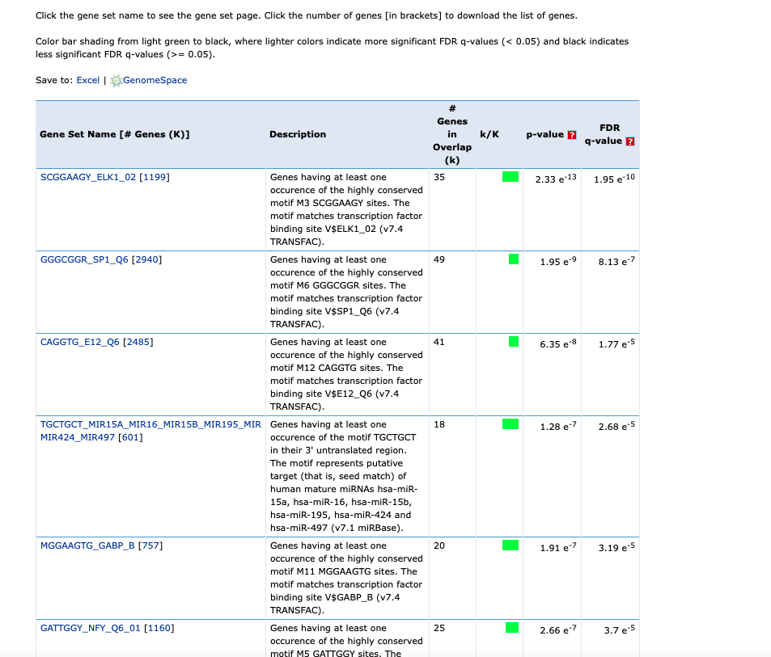
MSIGDB
So, which transcription factor is it?
Over 120 TFs were significant for my modules

Slide 15
Text-mining
Reduced list to 19 transcription factors
Included known transcription factors such as JUN
SP1 had little evidence of association with Parkinson’s/MPTP but was in every module
TF | Abstract for Parkinson's | MPTP/MPP+ | Module | FDR Corrected P-Value MSigDB
JUN | 4451 | 729 | BROWN | 3.44E-08
NRFR2 | 59 | 25 | SALMON | 6.23E-03
FOXF2 | 21 | 1 | BROWN | 1.69E-07
SP1 | 12 | 2 | BROWN | 4.25E-26
 |  |  | CYAN | 2.51E-06
 |  |  | MAGENTA | 8.08E-05
 |  |  | MIDNIGHT BLUE | 2.53E-03
 |  |  | SALMON | 7.85E-05
Notes:
Figure out with TF links to biology

Slide 16
Interpreting TF Enrichment Statistics
Don’t trust the p-values - they are always inflated because of the substantial non-random duplication of possible TF binding sites in throughout the genome
It is essential to incorporate other data - text-mining, wet-lab studies, other gene-expression data sets etc.
Notes:
Never ever trust p value ---- text mining, gene expression study, figure out if it is really there……..

Slide 17
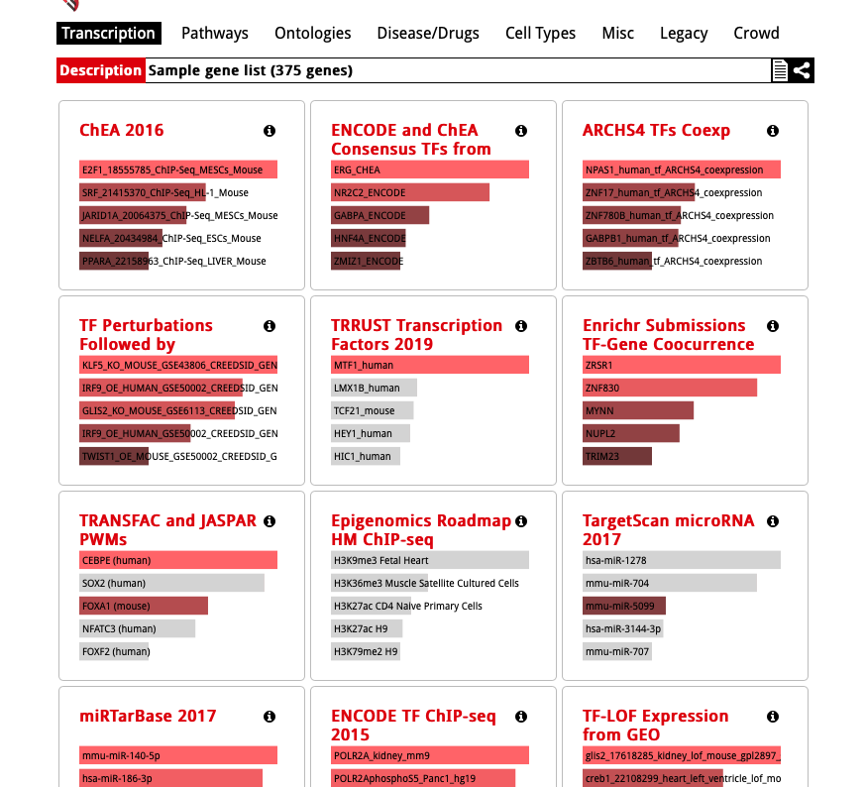
EnrichR includes TFs and other regulatory motifs
Pro’s: Includes many sources of data
Not restricted to humans
The statistics are only corrected for multiple hypothesis testing in each subcategory

Slide 18
FANTOM
Includes calculated TF binding sites, CHEA data set, published protein-DNA interactions, and perturbation experiments
Visualizes, but does not calculate statistics
Remember that your transcription factor is most likely *not* in the data set as they are often not regulated by
Notes:
Transcription factor regulated by phosphoration / dimerization / be cautious about that….

Slide 19
FANTOM
green indicates ChIP data
red indicates perturbation experiment
yellow published protein–DNA interactions
purple indicates protein–protein interaction.
Notes:
High-throughput data ---true false

Slide 20
microRNA
Few high-throughput experiments for microRNA/gene interactions
microRNA binding sites are extremely hard to predict - currently based on a combination of RNA thermodynamics and sequence conservation
When tested experimentally, most predicted microRNA-gene interactions result in variability < baseline variability

Slide 21
microRNA
Enrichment statistics are extremely difficult to calculate and trust because:
We don’t know the true background
Many genes have multiple putative microRNA sites
MicroRNA usually effect relatively few genes, so the signal-to-noise ratio is low

Slide 22
For this week:
Analyze your genes in EnrichR’s TF (or other regulatory motif) databases for enrichment - do any make sense?
Think about: what system am I studying these in? What is the known biology?
Analyze your list in FANTOM - does it look like a plausible network? Based on predictions or based on known experimental interactions?
Can you make an educated guess as to what might be driving gene expression?
Is there any literature support for the interactions?
Notes:
Network protein-interacting string sparse Fantom
https://fantom.gsc.riken.jp/4/edgeexpress/subnet/#subnet2
FANTOM Predicted transcription factor binding site…… gene view subnet view ---analyze data ***hide singleton
STRING: HIDE unconnected genes/ hide
https://fantom.gsc.riken.jp/4/edgeexpress/subnet/#subnet2
encode and chea consusus transcription factor
https://maayanlab.cloud/Enrichr/ Genome Browser PWMs microRNA
miRTarBase 2017
SPI1 ---predicted binding sites SOX2---TF will be activating site

